Slide 1
*LESSON PLAN* *Subject Physical Education* *TOPIC First Aid*
Submitted to: Madam Meena Arora
Submitted by: Asha Rani

Slide 2
ivid:AiD:dw rol nM:104 jmwq:A`TvI ivSw:srIrk is`iKAw imqI: au`p ivSw: mu~FlI shwieqw smW:35 imMt
sDwrn s`mgrI: blYk borf,jmwq dw kmrw,cwk,JwVn,sMkyqk ivSyS sm`grI: pwvr puAWiet pySkwrI duAwrw | sDwrn audyS: 1.b`icAW iv`c srIrk is`iKAw pRqI rucI pYdw krnw 2.b`icAW dI klpnw SkqI dw ivkws krnw 3.b`icAW nUM s`tW qo bcwau dI is`iKAw dyxI ivSyS audyS: b`icAW nUMmu`FlI shwieqw bwry jwxkwrI dyxw pUrv igAwn dI pr^: 1.b`icau!quhwnUM Gr jW skUl iv`c ikhVIAW durGtnwvW dw swhmxw krnw pYdw hY | 2.Kyfdy smy swnUM iks-iks qrW dIAW s`tW l`g jWdIAW hn 3.jdo iksy dy s`t l`gdI hY qW qusI kI krdy ho 4.ijhVI shwieqw fwktr dy Awaux qo pihlW id`qI jWdI hY ausnUM kI kihMdy hn au`p ivSy dI GoSxw: ividAwrQIAW v`lo sMqoKjnk jW AsMqoKjnk au`qr imlx qo bwAd ivid.AiD. d`sygI ik A`j AsI mu~FlI shwieqw bwry pVWgy | pRsquqIkrn: ivid.AiD. vrxwqmk qy pRSn au`qr ivDI rWhI pVweygI |

Slide 3
ivSw-vsqU | ivid:AiD:ikirAw
mu`FlI shwieqw:- mnu`KI jIvn iv`c iksy vI smy, iksy vI sQwn ijvy Gr,skUl,kwlj,d&qrW Awid iv`c durGtnwvW awm dyKx nUM imldIAW hn| mSInW dI Brmwr, v`D rhI v`so Awid kwrn durGtnwvW vI v`D rhIAW hn, durGtnwvW qo qurMq bwAd mu`FlI shwieqw dyxI jrUrI hY| mu`FlI shwieqw qo Bwv aus shwieqw qo hY jdo iksy P`tV ivAkqI nUM fwktr dy Awaux qo pihlW id`qI jWdI hY| mu`Fly shwiek dy gux:- mu`FlI shwieqw dyx vwlw ivAkqI su`cjw Aqy cusq hoxw cwhIdw hY qW jo auh CyqI hI rogI dy l`Cx jwx sky| auh bVw jugqI hoxw cwhIdw hY qW jo rogI dI hwlq nUM Krwb hox qo bcw sky| auh AxQ`k qy idRV ivAkqI hoxw cwhIdw hY| | ivid:AiD: b`icAW nUM mu`FlI shwieqw bwry d`sygI| ivid: AiD:mu`Fly shwiek dy gux bwry puCygI?

Slide 4
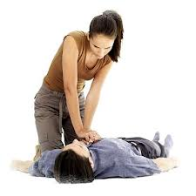
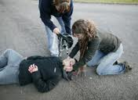
ividAwrQI ikirAw | shwiek- sm`grI | cwk- borf kwrj
ividAwrQI iDAwn nwl suxngy| ividAwrQI au`qr dyx dI koiSS krngy| |  | mu`FlI shwieqw mArQ:- auh shwieqw jo dwktr dy Awaux qo pihlW idqI jWdI hY auh mu`FlI huMdIhY| mu`Fly shwiek dy gux: auh su`cjw, cusq qy PurqIlw hoxw cwhIdw hY|

Slide 5
ivSw-vsqU | ividAwrQI ikirAw
mu`FlI shwieqw dIAW jrUrI hwlqW bwry jwxkwrI:- 1.s`p lVn qy mu`FlI shwieqw: zihrIly Kun dy dOry nUM rokx leI pRBwivq AMg nUM au~pro idl vwly pwsy qo k`pVy nwl Gu`t ky bMnH idau| d`s-vIh imMt mgro ie`k jW A`Dy GMtY leI Kolo, f`sI QW qY cwkU nwl ie`k ieMc cOVw k`t lgwau qy lwl dvweI nwl Do idau| 2.A`g l`gx qy mu`FlI shwieqw: A`g l~gx qy rogI dy k`pVy nW auqwry jwx,nW hI Cwly qoVy jwx| rogI nUM kMbl iv`c lpyt idau,sVn vwlI QW nUM iktwxU rihq kro| rogI dI rog vwlI QW qy rUM dI g`dI bxw ky p`tI kro| | ivid:AiD: ividAwrQIAW nUM s`p dy lVn qy mu`FlI shwieqw bwry d`sygI | A`g l`gx qy mu`FlI shwieqw ikvy dyxI cwhIdI hY|

Slide 6
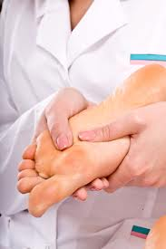
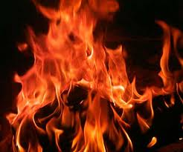
ividAwrQI ikirAw | shwiek-sm`grI | cwk-borf kwrj
ividAwrQI iDAwn nwl kwpIAW qy not krngy| ividAwrQI au`qr dyx dI koiSS krngy| |  | s`p lVn qy mu`FlI shwieqw:cwkU nwl ie`k ieMc lMbw k`t lgwau| rogI dy k`pVy nW auqwro,nW hI Cwly qoVo|

Slide 7
ivSw-vsqU | ivid:AiD:ikirAw
3.ibjlI dw Jtkw l`gx qy mu`FlI shwieqw:- ibjlI dI nMgI qwr nUM h`Q lwaux nwl zbrdsq Jtkw l`gdw hY,keI vwr mOq vI ho jWdI hY| rogI nUM bcwaux leI l`kV dI sotI qy rbV dy dsqwny dI vrqo kro| 4.pwxI iv`c fu`bx qy mu`FlI shwieqw:- pwxI iv`c fu`by ivAkqI nUM mUDw krky iF`f iv`co pwxI k`F idau| ig`ly k`pVy auqwr idau qy ausnUM grm k`piVAW iv`c lpyto| | ivid:AiD:b`icAW nUM ibjlI dw Jtkw l`gx qy mu`FlI shwieqw bwry d`sygI| pwxI iv`c fu`by ivAkqI dI shwieqw ikvy krogy|

Slide 8
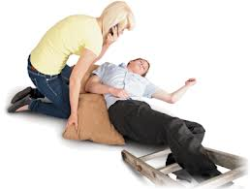
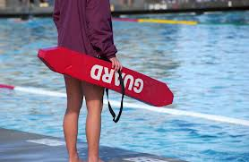
ividAwrQI ikirAw | shwiek-sm`grI | cwk-borf kwrj
ividAwrQI iDAwn nwl suxngy| ividAwrQI au`qr dyx dI koiSS krngy| |  | ibjlI dw Jtkw l`gx qy shwieqw:l`kV dI sotI qy rbV dy dsqwny dI vrqo kro| ig`ly k`pVy auqwro qy grm k`piVAW iv`c lpyto|

Slide 9
AMiqm duhrweI: zKmI nUM id`qI jwx vwlI shwieqw nUM kI kihMdy hn? s`p dy lVn qy ikhVw ielwj kIqw jwdW hY? mu`Fly shwiek dy ikhVy gux hoxy cwhIdy hn? krMt l`gx qy qusI mu`FlI shwieqw ikvy dyvogy?
Gr dw kMm: ividAwrQI AiDAwpk b`icAW nUM Gro mu`FlI shwieqw bwry pVH ky Awaux leI khygI|

